Slide 1
Train-the-Trainers:
Mentoring Training focused on Excellence and Professionalism
in the Law
Notes:
[Introduction of the evening’s host/facilitator.]
Do you remember what is was like starting out as an attorney, wrestling with questions both big and small?
Does anyone want to share some of the questions they can remember having?
Those were awkward – and sometimes painful times.
Now is your chance to “pay it forward” and help those coming up with those very same issues.

Slide 2

You’re awesome!
Notes:
If you’re here, that means that you feel you have something of value to share with others.
We believe that to be 100% true.
We’re going to acknowledge right up front the experience and expertise that you bring to the table.
Show of hands: how many have been practicing for…
Less than 2 years?
3 – 5 years?
6 – 10 years?
11 – 20 years?
More than 20 years?
Whatever your career stage, you are bringing something special and specific to the table. THANK YOU!
Show of hands: who is in the room?
How many attorneys?
Any judges?
How many folks from large firms?
Small firms?
The public sector?
It is nice to have this kind of diversity in the room. THANK YOU.
What we’re hoping to accomplish is a kind of refresh so that you can remember what it felt like when you first starting out.
The program will:
Help get you into the right mindset for mentoring
Remind you of what it’s like to walk in the shoes of a law student
Review what it’s like to be a newly minted attorney looking for work
Shed light on what the newer associate is facing as they get further into the legal thicket

Slide 3
What We’ll Cover
The importance of mentoring
The world of the new attorney
Feedback
Common issues
What’s in it for you?
And more!
Notes:
During the program we’ll cover:
The importance of mentoring in the legal profession
The world of the new attorney
Giving and receiving feedback
Common issues faced by less experienced practitioners, including ethics
The benefits of being a mentor
And more.

Slide 4
Bridging the Gap
What it means to be an Attorney
General Legal Procedures
Ethical Problems
Legal Analysis and Reasoning
Legal Research and Writing
Client Relations
Litigation
Alternative Dispute Resolution ("ADR") and Negotiation
Organization and Management of Legal Work
Work/Life Balance and Career Planning
Notes:
Just because you pass a test, doesn’t mean you understand real-life repercussions.
Mentoring is the thing that bridges that gap.
Many folks who are getting ready to graduate, or have just started their first legal job are clueless – these are the things that they either never learned about in law school or are encountering now for the first time.
Some folks are lucky to have a large firm with partners and experienced associates to help them; others do not have those luxuries.
This training will help set you up to help them successfully navigate this unchartered territory.

Slide 5
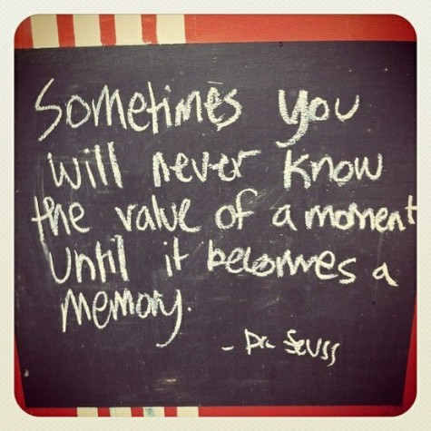
Mentor Moment
Notes:
5 minutes for someone – a special guest, long-time member, Inn president, etc. – to share a story of one of their mentors and a difference that it made in their life/career.
Keep it short and inspirational!

Slide 6
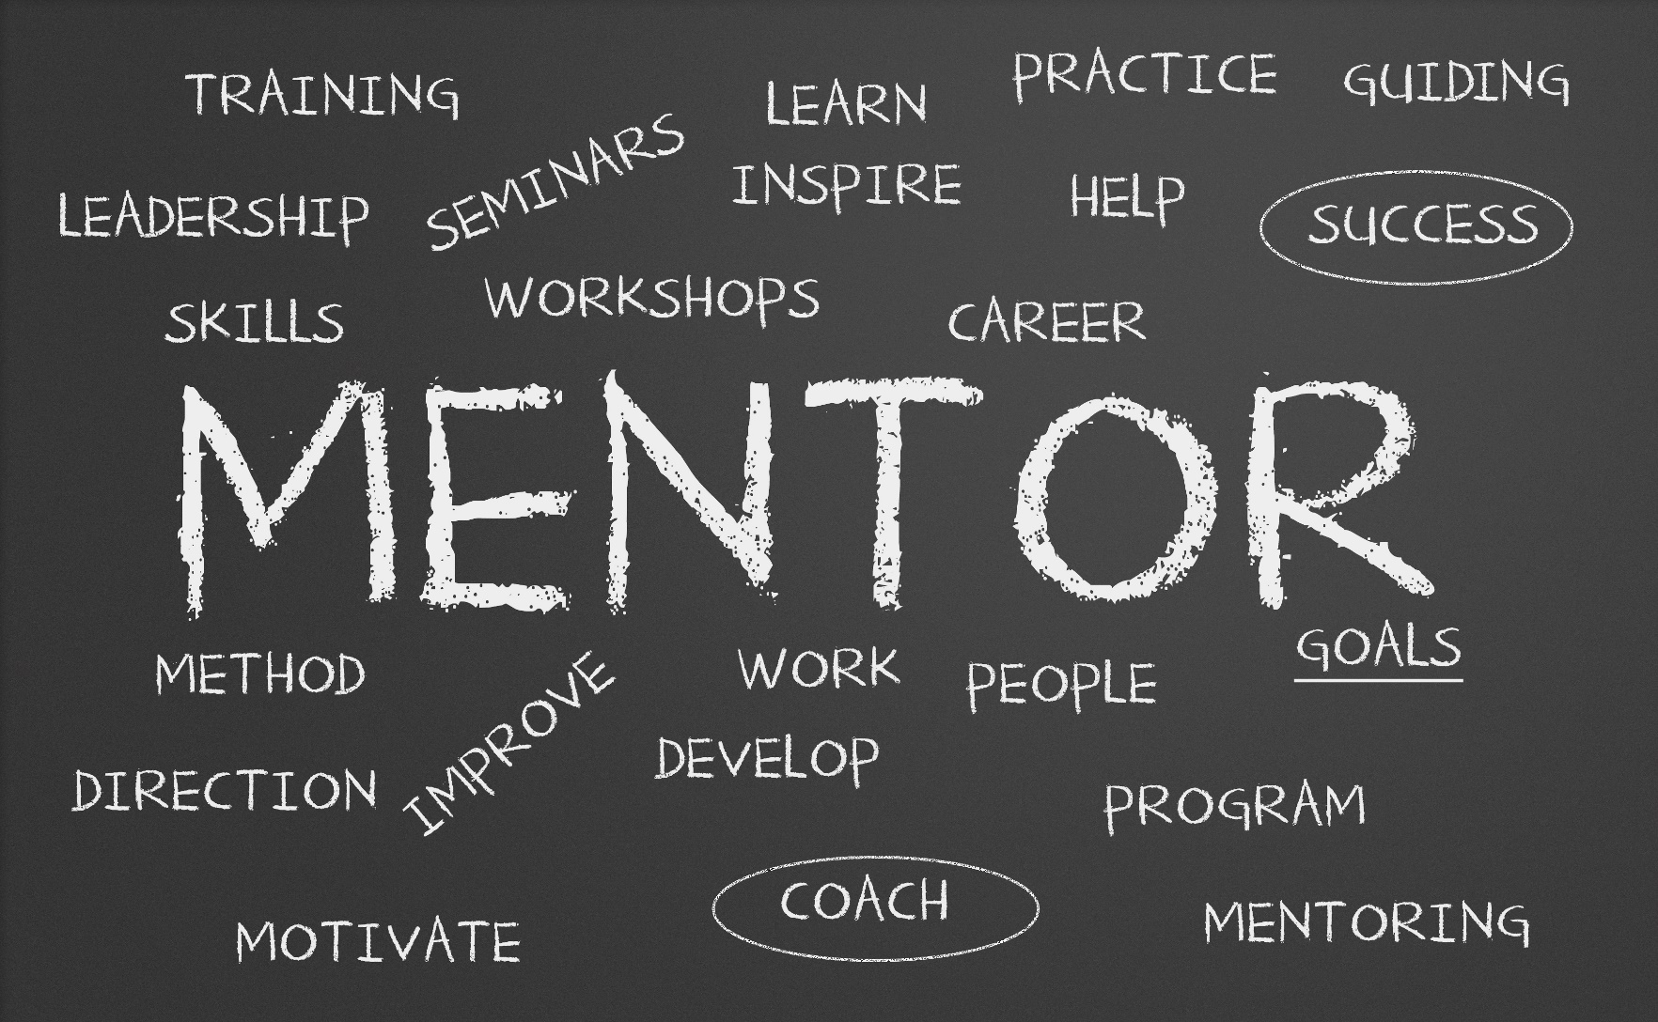
Why mentoring?
Notes:
Mentoring is a classic example of paying it forward.
By providing direction and support in career development, you are helping to improve career satisfaction and, therefore, bolster the profession.
Mentoring is a time honored legal tradition and a cornerstone of the American Inns of Court.
AIC’s Professional Creed states a goal of upholding "the highest standards of excellence in professionalism, ethics, civility, and legal skills" and attaining "the highest level of knowledge and skills" in every members' practice area.
Mentoring …
…cultivates professional distinction.
…fosters excellence in professionalism, ethics, civility, and legal skills.
…assists members in developing high standards of professionalism.
…leads to internalized principles of appropriate behavior consistent with the legal professions' core values.

Slide 7
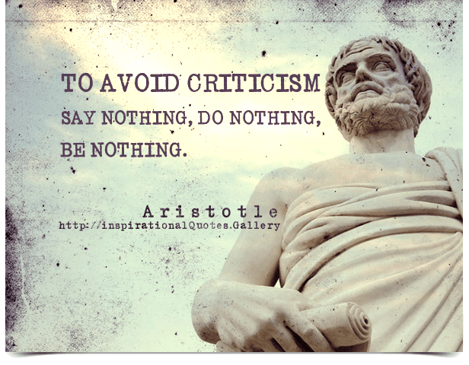
Managing Emotional Reactions to Criticism
Notes:
One of the keys to being a successful mentor is how to relay information that someone doesn’t expect or want to hear.
It’s hard for everyone to hear how they didn’t do well or that they should do something differently.
However, if you have some tools, tips and techniques to help you understand your audience and how to communicate in an effective way with them, you will set yourself up for success.
Let’s start by talking about what the world looks like for today’s new attorneys.

Slide 8

The World of the New Attorney
Notes:
[Group discussion]
How have things changed since you graduated from law school?
Societal changes
Gender issues
Racial issues
Technology
Job security – finding jobs
Financial pressures – law school debt, loans
Politics
Judiciary
Let’s review some generational differences – these points are generalizations, but they are still helpful when understanding how best to communicate with folks in your legal sphere.

Slide 9
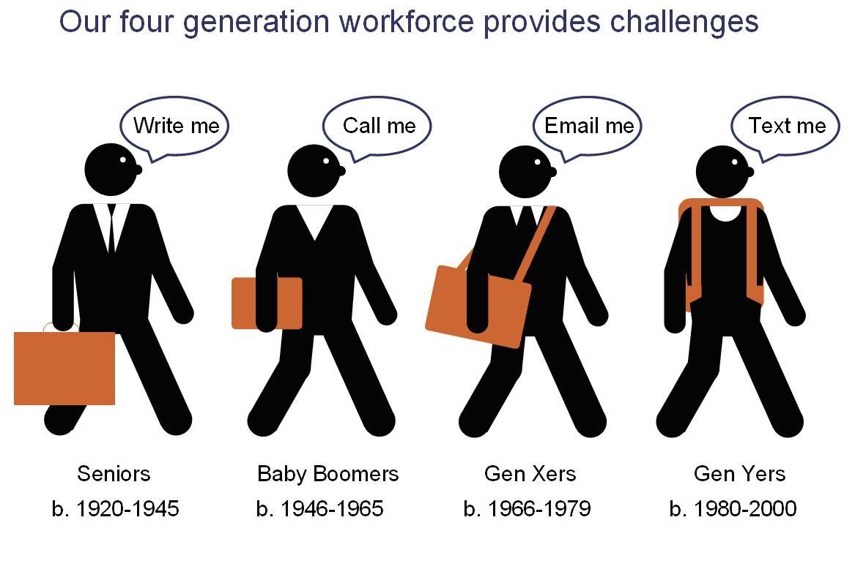
Generational Differences
Notes:
Baby Boomers
Emphasize learning by doing "I had to figure it out on my own...you figure it out yourself!“
This is where you find the majority of your partners and more senior attorneys…also the biggest pool of mentors!
Generation X
Thrive on sure paths and within defined structures
Prefer individualized approaches to advancement, not institutionalized
Not big question askers
These are a lot of our junior partners and senior associates
Gen Y or Millennials
This is a generation of lawyers born between 1980 and 2000 – comprise about 20% of lawyers and 33% of the general workforce
These are the majority of attorneys who need mentoring
Need feedback on work product and need it often
Thrive on open learning and communication
Appreciate and expect transparency - seek knowledge of what is needed for success
Important for them to be recognized (the "everyone gets a trophy" generation!)
Can be shocked or unpleasantly surprised by criticism and expect apologies when they feel they're wronged

Slide 10

Feedback: Giving It
Be empathetic
Timely
Constructive
Face-to-Face
Tie to performance
Tone matters
Avoid labels
Notes:
We've already established that our biggest pool of mentees crave feedback...so what's the best way to give it?
Empathy goes a long way – put yourself in their shoes!
Ensure it's timely
Don't talk in October about something that happened in July!
Always easier to correct or adjust when something is fresh.
Negative feedback should be as constructive as possible.
Deliver feedback – especially criticism - face-to-face if at all possible - never by email!
Tie feedback to performance.
Stay objective, describe observable behaviors.
Keep emotions, personality or motives out of it.
Watch your tone.
Feedback is much more effective when it is shared calmly and in a friendly manner.
Avoid using labels.
Instead, describe the problematic behavior or incident.

Slide 11

Feedback: Receiving It
Don’t take it personally
Be open
Change is good.
Listen
Notes:
Mentoring is a two-way street…your mentees could (and should!) have feedback for you, as well. So what's the best way to take it in?
Feedback isn't personal - it's a chance to learn how to do better
Be receptive and appreciative, even if it's negative!
Resist the urge to be defensive and argumentative
Discuss how you can change things moving forward.
Engage in active listening
Listening is the underrated skill in mentoring relationships.
Mentors can learn so much if they stop talking and listen.
Don't interrupt - save questions for the end
This can inform your responses and what kind of advice you might give.
It makes the mentee feel valued and respected.

Slide 12

Common Issues
Notes:
We’re going to now discuss some of the more common issues that less experienced attorneys often face in the first few years of entering the profession.
We’ll start with ethics and then tackle a hodge-podge of other issues.

Slide 13
Ethical Tripwires & Pitfalls
Misleading advertising
Candor towards the tribunal
Confidentiality
Competence
Responsibilities of a subordinate lawyer
Conflicts of interest
Bad behavior
Notes:
Ethical dilemmas and situations are probably the largest category where less experienced attorneys can benefit from mentoring.
Misleading advertising:
Financial pressure on newly graduating attorneys: tuition outpacing salaries, student loan debt on the rise
Ease of access through social media
Many state rules governing professional conduct cover direct contact, advertising for specialty fields, prohibition on misleading or false claims about a lawyer’s services
How all this plays out with social media
Candor towards the tribunal:
Everyone knows you don’t lie to judges
But a nervous attorney faced with the dilemma of a false statement of fact or law may not have that gut reaction
Rules where attorney’s are required to effectively making opposing counsel’s case for them
Can also adversely affect clients
Failing to address adverse authority is not only a rule violation, but can also damage reputations (both at the bar and the bench)
Confidentiality:
Broadly, prohibited from revealing information without the consent of the client or if necessary for the case
No exceptions for cocktail party chatter, complaints about a client’s personality or anything else that – even if delivered anonymously, because it can be discovered through context
Handling hypotheticals correctly
Competence:
A lawyer must provide “competent representation”…what does that mean?
How do you handle the rule that requires attorneys to identify areas that are beyond their competence and bring it to the client’s attention
New attorneys may be tempted to take on work even if it’s beyond the scope of their expertise
Responsibilities of a subordinate lawyer:
If someone else is supervising the case, the subordinate attorney is not off the hook for ethical decisions gone awry
Both parties are held equally responsible, except in matters of “reasonable resolution”
The outranked attorney should be prepared to raise issues that they identify or have questions about
Conflicts of interest
Surrounded by poor role models/bad behavior

Slide 14

Other Themes
Notes:
[Group discussion]
Digital Citizenship in today’s workplace (What is this??)
Researching jobs and interviews
Networking: making friends before you need them
Associate life
Differences between small firms and large firms
Defense vs. Prosecution
Professionalism
Civility with opposing counsel
What else?

Slide 15
Mentoring Program Effective Practices
Be inclusive
Identify a champion
Have a structure and measurable goals
Mix it up!
Shared interests
Participate in pairing
Recognize mentors
Notes:
If you’re going to have a mentoring program in your Inn, be sure to keep these things in mind:
Include junior attorneys, paralegals and legal assistants in ethics training
While everyone in the Inn should have shared responsibility, there should also be an identified mentoring champion
Develop a structure and measurable goals including checkpoints to review progress
Pair different generations in mentoring relationships, also consider career stages and other ways to diversify pairings or groups
Differences are important, but one of the most difficult but most rewarding things you can do in pairing people is finding “uncommon commonalities” or “shared uniqueness”
Allow mentors & mentee to participate in the pairing process as appropriate
Recognize mentors, especially those who are outstanding – codify what makes them outstanding and share the wealth!

Slide 16
Mentor Moment
Notes:
5 minutes for someone – a special guest, long-time member, Inn president, etc. – to share a story of one of their mentors and a difference that it made in their life/career.
Keep it short and inspirational!

Slide 17
What’s In It For You?
For the Profession:
Values & Standards
Ethical awareness
Skill-building
Involvement
For the individual:
Skill-building
Increase self-worth
Re-energize your career
Notes:
Mentoring is a cornerstone of the American Inns of Court movement, by fostering excellence in professionalism, ethics, civility, and legal skills.
Goals of Inn mentoring efforts should be:
Develop an understanding of generally accepted professional values and standards of behavior and the importance of professionalism in the practice of law.
Build awareness of ethical obligations and of proper practices for avoiding mishandling of other's assets, conflicts of interest, neglect of matters, and civil liability problems.
Improve professional skills necessary for the effective practice of law at a high level of competence.
Develop an appreciation of the importance of supporting and improving the justice system, improving access to justice and the importance of active involvement in the profession and the community.
Mentoring is a classic example of paying it forward and it can also really benefit the mentor in many ways:
Mentors end up honing their own skills, such as active listening and interpersonal relationship building.
In addition to lifting up the mentee, involvement with mentoring can help increase you sense of self-worth and reenergize your own career.
By providing direction and support in career development, you are helping to improve career satisfaction and, therefore, bolster the profession.
Mentoring is an activity critical to the health and future of the profession.
Helping those new to the community can elevate the entire community.

Slide 18

Notes:
Thank you for your time and involvement!
Don’t forget to sign up to participate in our upcoming mentoring program [describe it here…]

