Slide 1
Internet Safety
[Inn Name], [Presenters]
May 27, 2021
Notes:
[If this is your first presentation during the program, introduce yourselves and explain the American Inns of Court. Presenters are encouraged to speak from their experience as appropriate during the presentation. This helps students connect with you as the presenter and with the material.
Reminder: This presentation is a template. Feel free to adapt it as needed.]

Slide 2
Overview
Cyberbullying
Sexting
Social media
Email scams
Online shopping
This Photo by Unknown Author is licensed under CC BY-SA

Slide 3
Cyberbullying
What is cyberbullying?
Who is affected by cyberbullying?
Notes:
Cyberbullying is when a person uses a cell phone, computer or other electronic means to taunt, harass, torment, humiliate or threaten another person. Usually, the behavior must be repeated and cause harm to be characterized as cyberbullying. A cyberbully might post humiliating photos of a classmate online or launch an online campaign of horrible rumors about a peer. Cyberbullying can lead to anxiety and depression in young victims and, in some cases, lead to suicide.
Each state has different definitions and laws regarding bullying. [Explain the laws in your state.]
Cyberbullying can happen to anyone, even (and perhaps especially) celebrities: https://www.youtube.com/watch?v=E7GgTCWfBgQ.
If you or someone you know is the victim of cyberbulling, you can call the national Stop Bullying Now Hotline 24/7 at 1-800-273-8255.

Slide 4
Sexting
This Photo by Unknown Author is licensed under CC BY-NC-ND
Notes:
Sexting is sending sexually explicit digital images, videos, text messages or emails, usually by cell phone.
You can get into trouble if you download sexual pictures of children or young teens. Possession of or control over “child pornography” is a crime punishable by time in prison. Child pornography is not just limited to little kids; it can also include teenagers.
For example, if you are 18-year-old guy and have sexual photos of a younger teenage female, you may be in possession of child pornography under the law. If you are convicted of possessing (or attempting to possess) such material, or sharing that material with others, you would have to register as a sex offender for life.
Delete any email with an attached photo of child pornography immediately.
[Resource: Internet safety video – San Diego County Sherriff's Department: https://www.youtube.com/watch?v=ep2E5JopOCA&t=134s]

Slide 5
Social Media
Limit your exposure
Protect your identity
This Photo by Unknown author is licensed under CC BY-SA.
Notes:
Most social networks automatically set your account so “everyone” can see the information you post on the social network website, like who you are and what you do. You can decide how public you want to be with your privacy settings and with the content you decide to post. Periodically visit your account settings to customize your privacy settings to suit your tastes. Keep your circle of friends recognizable – if you let an unknown person join your network, that person’s friends can have access to your information, too.
Before sharing something online, take a minute and think about what you are posting and disclosing. Be careful about revealing where you are and never post that you will be away from home. Protect your personal information by not posting your email address (use the social network’s messaging tool instead), full date of birth (omit the year), home address, or phone number.
[Resource: Teen Voices – Oversharing and Your Digital Footprint: https://www.youtube.com/watch?v=ottnH427Fr8]

Slide 6
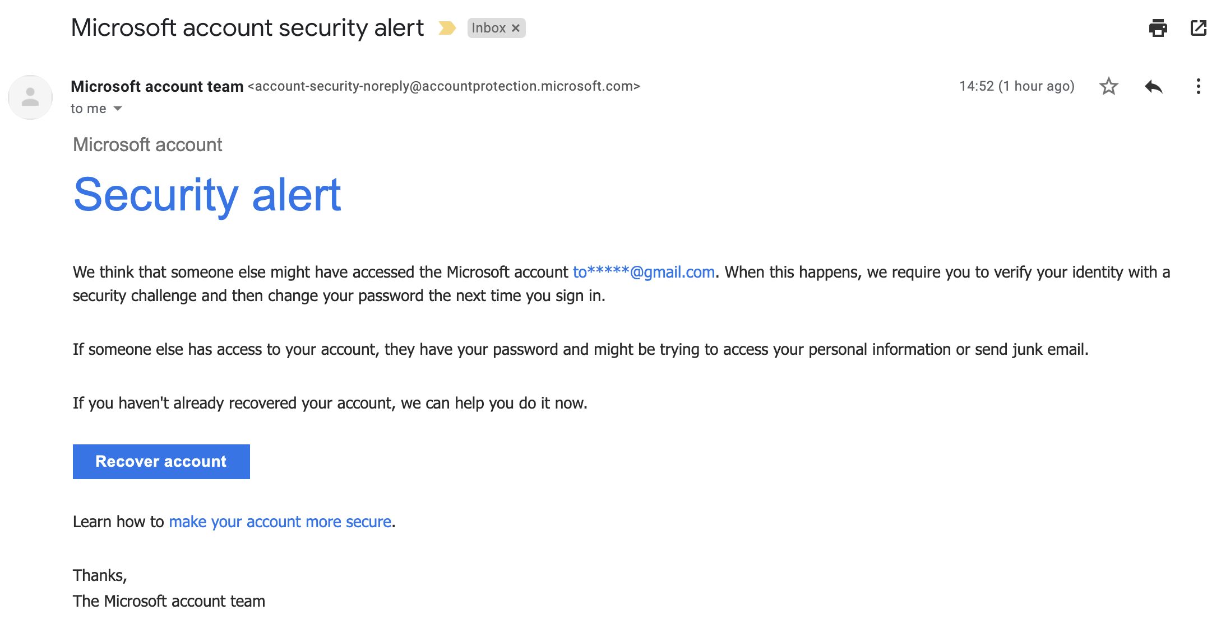
Email Scams
This Photo by Unknown Author is licensed under CC BY-SA
Notes:
What can you do to prevent being scammed?
Hover over links to ensure they are what they say they are
Update software regularly
Use multifactor authentication
Back-up data
Change passwords regularly and use strong passwords—don’t repeat passwords across sites!

Slide 7
Online Shopping
This Photo by Unknown Author is licensed under CC BY-SA
This Photo by Unknown Author is licensed under CC BY-SA-NC
Notes:
If you shop online, look for indications that the website is secure before you enter a credit card or other personal data. A data use notice should be included on any site that collects personal data. The notice should define the reasons and uses for the data collected, including any data collected through cookies or hidden programs. In the case that information is used for promotional or business purposes, or any other reason that is not a service to the consumer, the user must agree to this, usually via opt-in selections.

Slide 8
Quick Quiz
What is cyberbullying?
Why should I protect my Internet identity?
Name some ways to prevent being scammed on the Internet.
Notes:
[Have students discuss in small groups as time allows.]

Slide 9
Thank you
Questions?

