Slide 1
Finances
[Inn Name], [Presenters]
May 25, 2021
Notes:
If this is your first presentation during the program, introduce yourselves and explain the American Inns of Court.
Presenters are encouraged to speak from their experience as appropriate during the presentation. This helps students connect with you as the presenter and with the material.
Reminder: This presentation is a template. Feel free to adapt it as needed.

Slide 2
What is Credit?
This Photo by Unknown Author is licensed under CC BY-SA
This Photo by Unknown Author is licensed under CC BY-NC-ND
Notes:
Credit is the ability to borrow money. Credit is necessary to buy "big ticket" items (e.g. education, car, home). Borrowing money costs money as expressed as an interest rate. Having good credit permits borrowing money at a lower rate.

Slide 3
What is Debt?
This Photo by Unknown Author is licensed under CC BY
Notes:
Debt is money borrowed. We are all debtors—we have borrowed money to pay for things. While a certain amount of debt is inevitable, it is critical that debt is manageable based upon income. Having debt under control provides for financial freedom.

Slide 4
How do Credit Cards Work?
Credit limits.
Interest.
Monthly statements.
Minimum payments.
Reward programs.
Notes:
Credit cards are applied for. The important components include the credit limit and the interest rate. Statements provide how much has been spent using the credit card and requiring a minimum monthly payment. If only the minimum is paid, interest will accrue. Ideally, the entire balance is paid off—not just the minimum. Many credit cards provide rewards for using the credit card (e.g. travel miles, cash back).

Slide 5
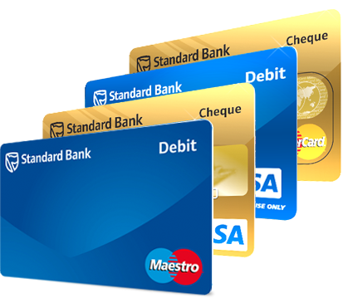
Credit Cards vs. Debit Cards
This Photo by Unknown Author is licensed under CC BY-NC
Notes:
Debit cards:
Tied directly to your checking account
Can be used where a credit card can be used
Uses a PIN to complete transactions
Good for daily use to help you stay within budget
Credit card:
Line of credit you can access with your card
Purchases usually require signature
Pay interest if balance is not paid off in 30 days
Use for hotel reservations, car rentals, etc.

Slide 6
Credit Cards and the Internet
Applying online
Online purchasing risks
Use of intermediaries (e.g., PayPal)
This Photo by Unknown Author is licensed under CC BY-SA-NC

Slide 7
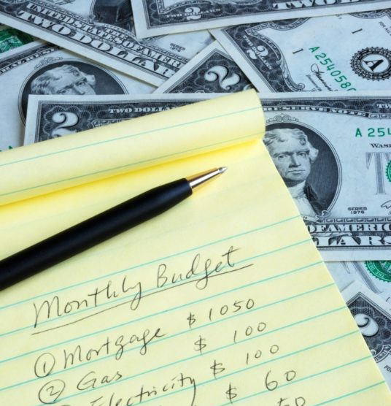
Budgeting
This Photo by Unknown Author is licensed under CC BY-SA-NC
Notes:
Budgeting is planning how money will be used to ensure spending is feasible and lifestyle is affordable. A budget is based upon actual income NOT credit limits. Budgeting ensures timely payment of bills, saving money each month, and understanding where money goes.

Slide 8
Build a Budget
Notes:
Go through the budget exercise. The students should fill out the Budget Worksheet based upon the numbers provided for either "Hypo 1" (high school graduate) or "Hypo 2" (college graduate).

Slide 9
Thank you
Questions?

