Slide 1
Employment
[Inn Name], [Presenters]
May 27, 2021
Notes:
[If this is your first presentation during the program, introduce yourselves and explain the American Inns of Court. Presenters are encouraged to speak from their experience as appropriate during the presentation. This helps students connect with you as the presenter and with the material.
Reminder: This presentation is a template. Feel free to adapt it as needed.]

Slide 2
Overview
Rights and benefits
Virtual workforce
Getting employed
This Photo by Unknown Author is licensed under CC BY-NC

Slide 3
Rights and Benefits
This Photo by Unknown Author is licensed under CC BY-SA-NC
Notes:
Employment terms will be defined in a contract, which will outline duties and responsibilities as well as compensation and benefits. Benefits will include breaks, vacation time, sick leave. It is important to review and be familiar with these terms.

Slide 4
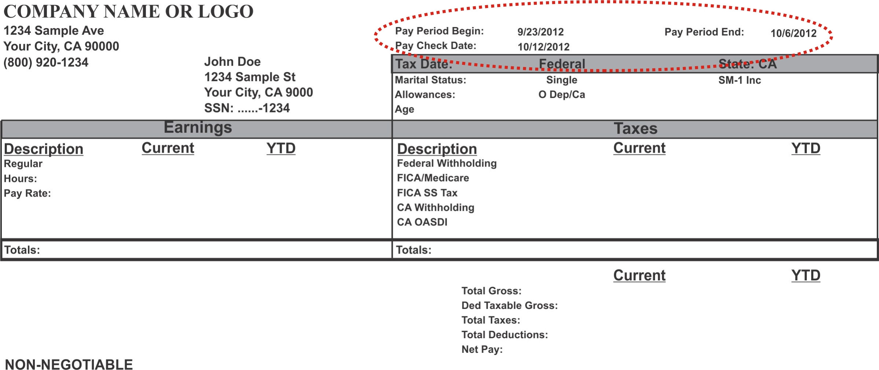
Understanding Paystubs
This Photo by Unknown Author is licensed under CC BY-SA
Notes:
[Explain the difference between gross and net pay. Explain the required deductions. Explain voluntary deductions (e.g., 401k contributions, additional tax withholdings). Explain that overtime and bonuses are also taxed.]

Slide 5
Virtual Workforce
Working Remotely
Technology
Notes:
In light of the COVID-19 health crisis, much work now takes place virtually. This provides for greater flexibility for workers, but also has challenges: staying focused, meeting with co-workers/clients, multiple people working from home in the same space, etc. It also requires a basic understanding and ability to use technology.
Some ways the pandemic may continue changing the way we work:
Hybrid working arrangements (going into the office some days, working from home some days)
Technology advancements
Job seekers’ expectations for increased flexibility
Office policies
Flexible work schedules

Slide 6
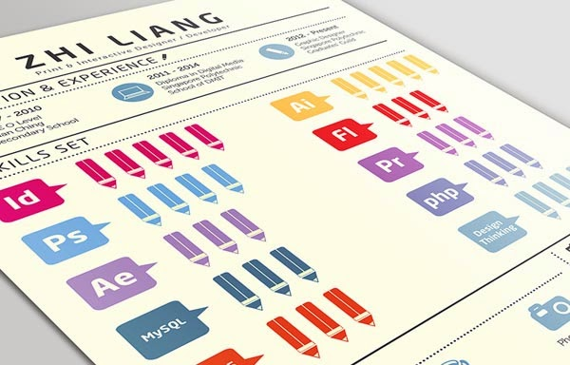
Your Résumé
Chronological
Functional
Hybrid
Infographic
This Photo by Unknown author is licensed under CC BY-SA-NC.
Notes:
1. Chronological Classic format that lists your work experience in order, starting with the most recent.
2. Functional Emphasizes qualifications and accomplishments instead of specific jobs but isn’t recommended.
3. Hybrid Modern format where skills and highlights go at the top before a detailed work history.
4. Infographic Uses icons and graphics to illustrate parts of your work history. This can be visually interesting but needs to maintain a professional design.

Slide 7
Interview Preparation
This Photo by Unknown Author is licensed under CC BY-NC
Notes:
[Discuss what to bring, what to wear, how to best prepare by practicing questions, what to do after the interview and what to expect after the interview.]

Slide 8
Interview Questions
Tell me a little about yourself.
What are your biggest weaknesses?
What are your greatest strengths?
Where do you see yourself in five years?
Out of all the candidates, why should we hire you?
Why do you want this job?
What do you consider to be your biggest professional achievement?
Describe your dream job.
Tell me about the toughest decision you had to make in the last six months.
Tell me about a time you disagreed with a decision. What did you do?
Notes:
[Have students to practice with each other answering these questions OR ask students to brainstorm answers/give answers to the group. Discuss the strengths and weaknesses of their answers.]

Slide 9
Thank you
Questions?

