Slide 1
Criminal Law: The dangers and pitfalls of underage sex
[Inn Name], [Presenters]
May 27, 2021
Notes:
[If this is your first presentation during the program, introduce yourselves and explain the American Inns of Court. Presenters are encouraged to speak from their experience as appropriate during the presentation. This helps students connect with you as the presenter and with the material.
Reminder: This presentation is a template. Feel free to adapt it as needed.]

Slide 2
What exactly is underage sex?
Notes:
You think it’s about the “dirty old men” cliché, right? But it’s not; here are some examples.

Slide 3
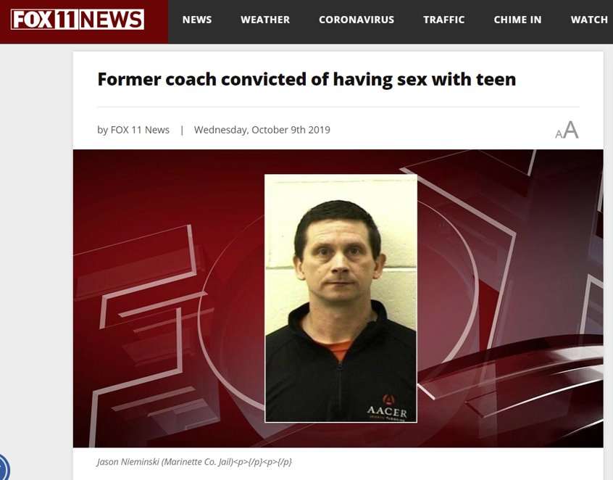
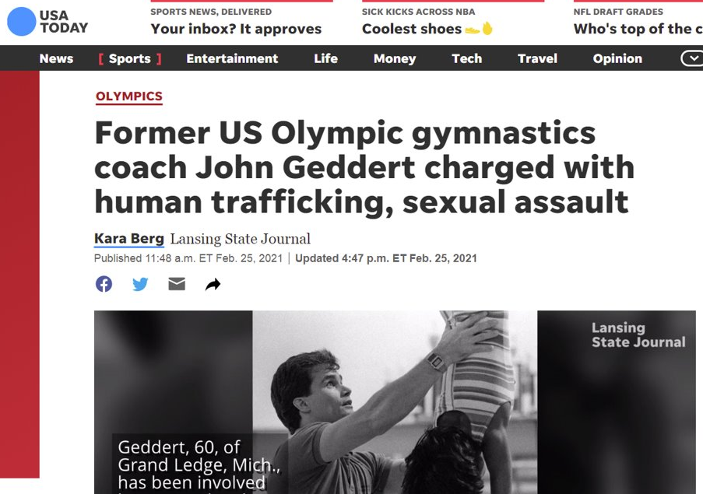
Underage Sex
Notes:
[Click to bring up screenshots of news articles one at a time (three total).]
You think it’s an adult having sex with a teenager, right? The ones you hear about in the news are teachers and athletic coaches having sex with their students.
We aren’t here to talk about this though. We are here to talk about sex between two teenagers who are under the age of consent.

Slide 4
Underage Sex
Age of consent
Sexting
Consequences
Notes:
There are three subjects we will be discussing on the topic of “Underage Sex”: The age of consent, which is the legal age to have sex in various states; sexting, which is when two (or more) people send sexually suggestive text and picture messages; and the consequences of each.

Slide 5
Age of Consent
Varies by state
Ranges from 16 years old to 18 years old
Minimum age of victim: anyone under that minimum age cannot consent to sex under any circumstances
More information: Department of Health & Human Services
Notes:
The age of consent varies by state. In certain states, it is 16. In other states, it is 18, which is also the legal voting age. What does this mean? It means that at that age of consent, you are considered able to have sex without breaking any laws, as long as the person you are having sex with is also at the age of consent. But what happens if one of you is under the age of consent? That is something we will be talking about in the “consequences” portion of our presentation.
Regardless of the age of consent in your state, federal law makes it a crime to transport a minor (a person under the age of 18) across state lines for the purposes of having sex with him or her.​
[Link navigates to table of age of consent, minimum age to prosecute, age differential by state.]

Slide 6
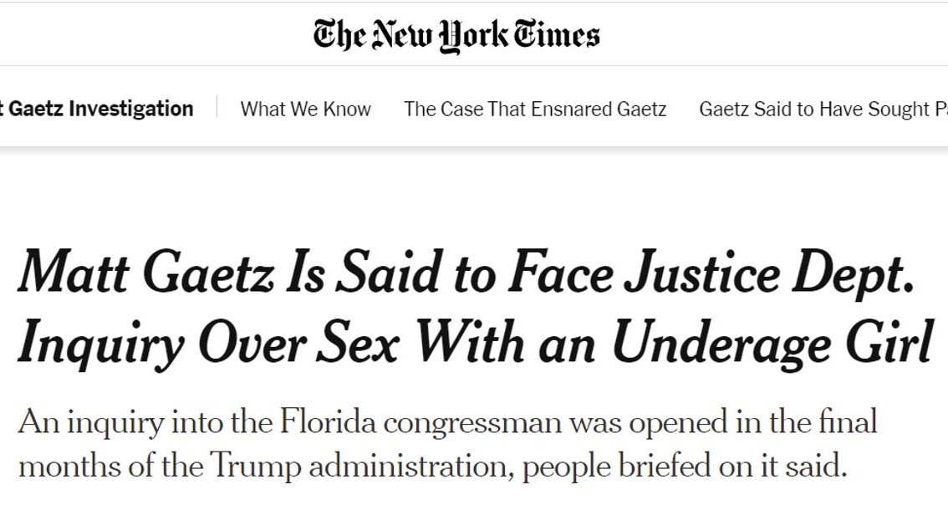
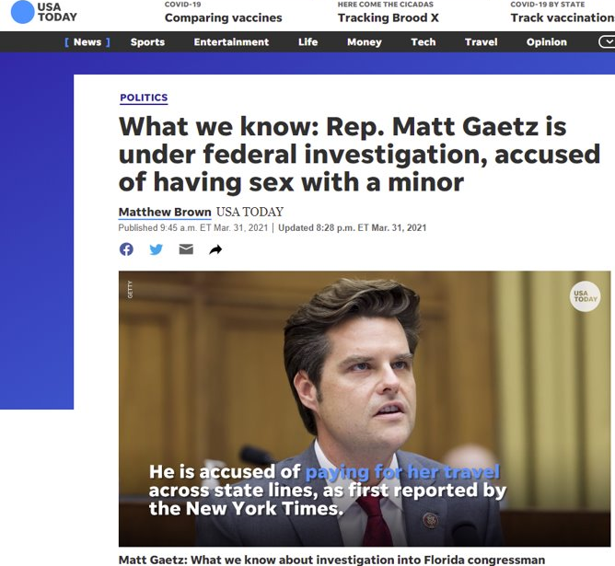
Age of Consent
Notes:
[Briefly give details of the Matt Gaetz investigation and how it relates to age of consent.]
Why is it illegal to transport a minor across state lines for the purposes of having sex?​
​
In Florida, the age of consent is 18 years old. That means, anyone having sex with another individual under the age of 18 can be prosecuted for statutory rape, a.k.a. unlawful sex with a minor.
In talking about underage sex, it's important to discuss grooming and sexual exploitation, which can involve sex trafficking. Grooming is a process by which a trafficker gradually gains a minor's trust, acting as a confidant and friend. They will often fill a need--for friendship, money, etc. The trafficker will slowly isolate the minor from family, friends, and help. Then, once the trafficker senses the minor trusts them completely, they will sexually abuse and exploit the minor, maintaining their control through threats. It is important to know the warning signs and where to go for help if you suspect this is happening. [Resource: https://u.osu.edu/swk5005/sample-page/.]

Slide 7
Sexting
Text (word) messages
Visual (picture) messages
Between minors, or between minors and adults
Notes:
What is sexting? There are two types of sexting, text messages and picture messages. Sexting is the sending, receiving, or forwarding of sexually explicit messages, photographs or videos, to others. The pictures can be of oneself or of another person, although it is typically of oneself. This is typically done through cell phones and now, through various apps, such as Snapchat. It can be done between minors or minors and adults. There are consequences for both as this also is dependent on the age of consent in the jurisdiction.
Consequences for sexting include jail, prison, and registration as a sex offender—possibly for life.
[Sources:
https://www.federalregister.gov/documents/2020/08/13/2020-15804/registration-requirements-under-the-sex-offender-registration-and-notification-act
https://ccresourcecenter.org/state-restoration-profiles/50-state-comparison-relief-from-sex-offender-registration-obligations/]

Slide 8
Child Pornography
Sexting → child pornography
Federal Law:
Not protected by the First Amendment
“Unfortunately, we´ve also seen a historic rise in the distribution of child pornography... Tragically, the only place we´ve seen a decrease is in the age of victims.” - Attorney General Eric Holder, Jr. at the National Strategy Conference on Combating Child Exploitation; San Jose, CA, May 19, 2011.
Notes:
What do you think child pornography is?
Child pornography is defined under federal law as the visual depiction of sexually explicit conduct involving a minor. A minor is someone who is under the age of 18 years. It doesn’t matter whether your state’s age of consent is 16 or 17. Federal law is what defines child pornography.
What you might not realize is that sexting (visual messages) could also be considered the making and/or distribution of child pornography.
[Briefly discuss federal law about child pornography. Note how serious the crime of possession is, and how prolific.
Sources:
https://www.justice.gov/criminal-ceos/child-pornography
https://www.justice.gov/criminal-ceos/citizens-guide-us-federal-law-child-pornography]

Slide 9
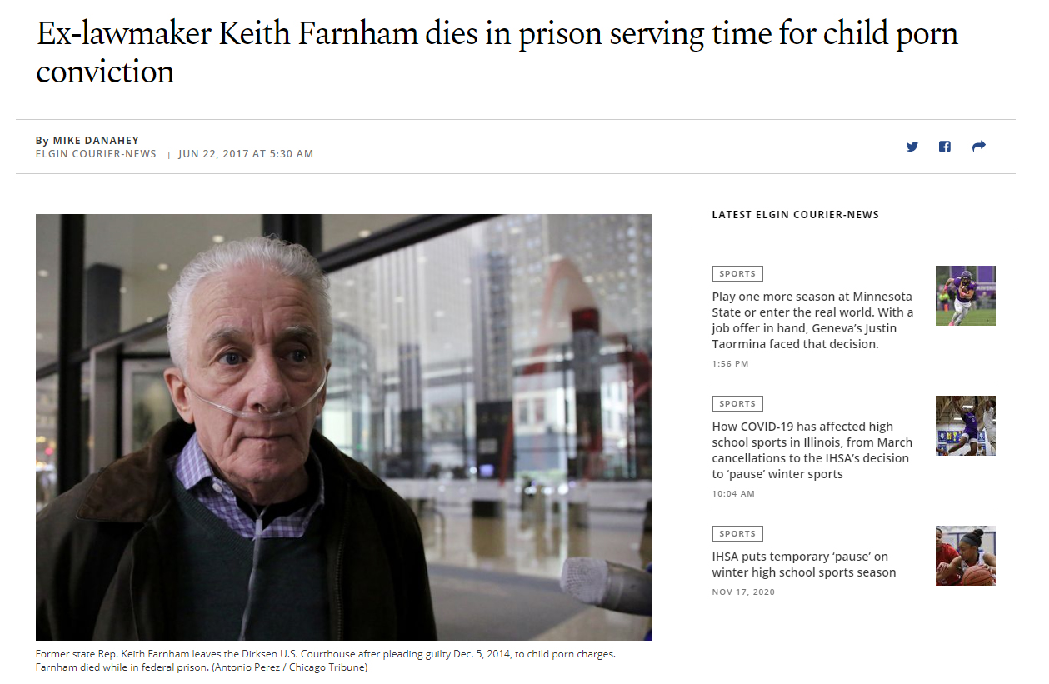
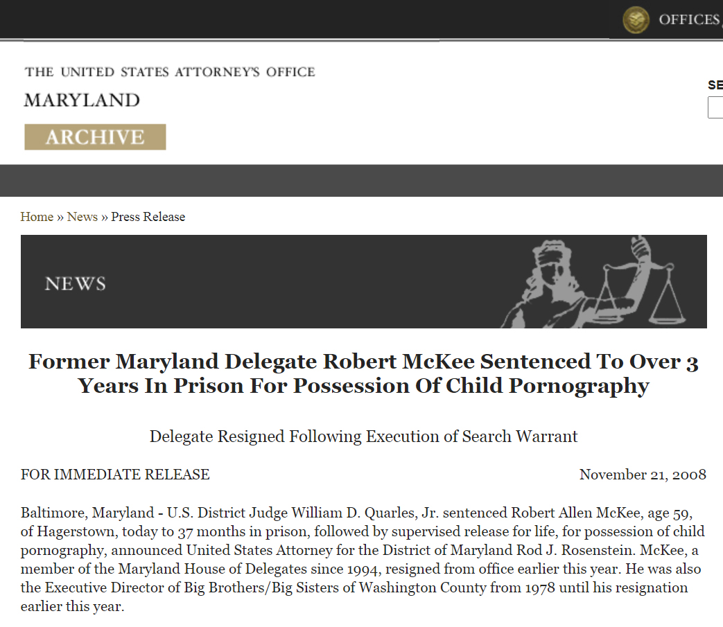
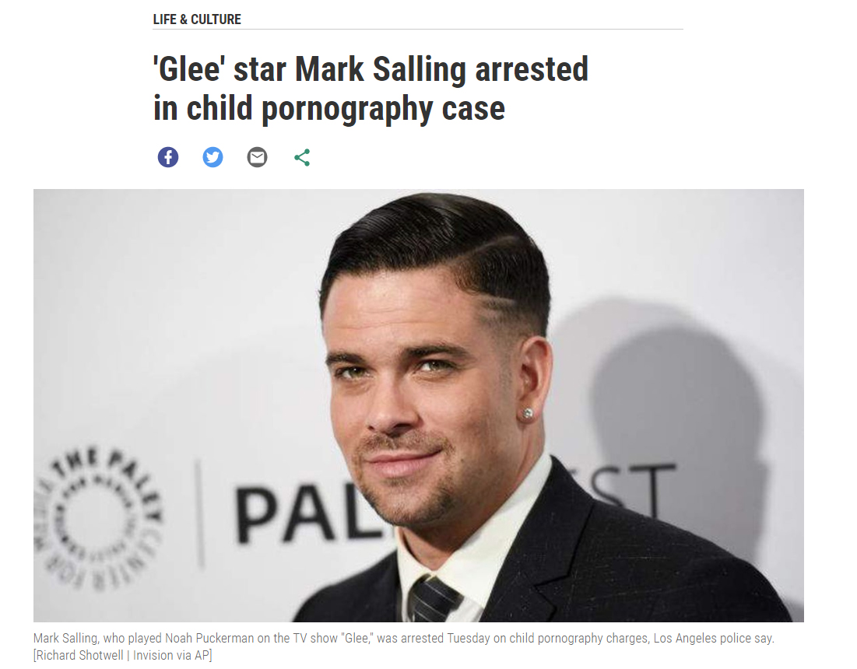
Child Pornography
Notes:
Examples of individuals who have been convicted of child pornography.
[Click to bring up screenshots of articles one at a time (three total).]

Slide 10
Consequences
What exactly is a sex offender?
Notes:
Again, you think of the cliché of a “dirty old man” right?

Slide 11
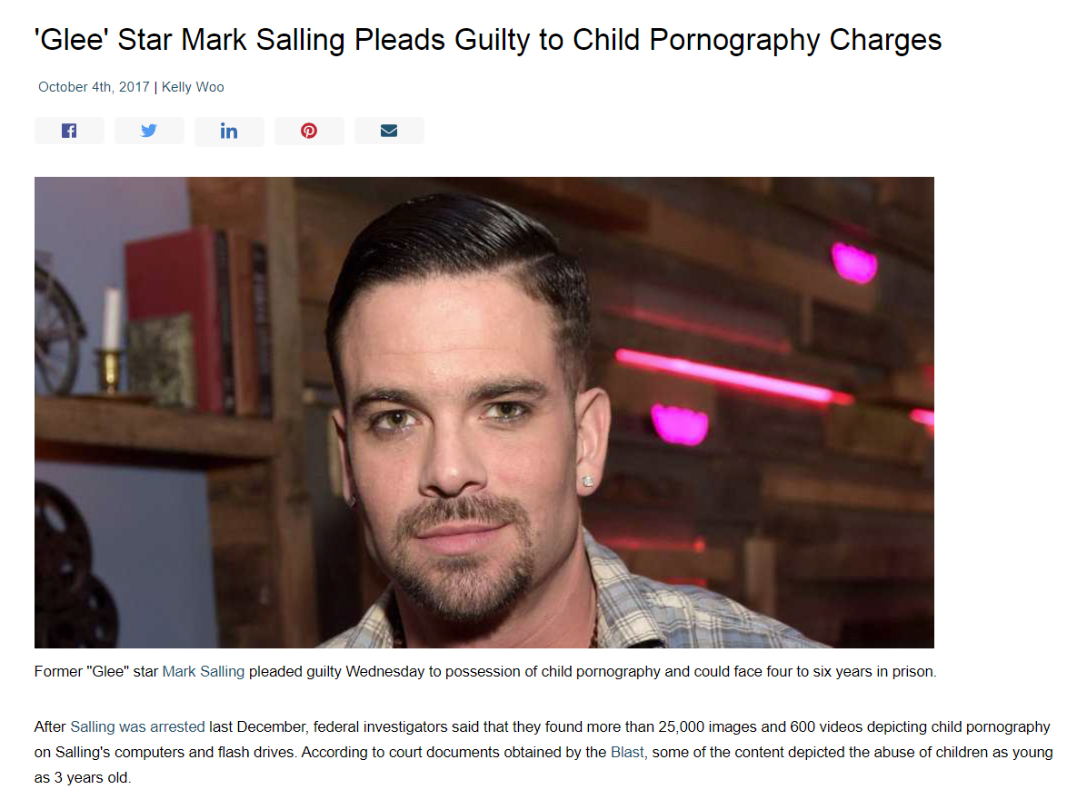
Consequences
Notes:
Had Mark Salling lived, he would have been required to register as a sex offender for the rest of his life.
A search of the federal registry of sex offenders reveals offenders of all ages and ethnicities.

Slide 12
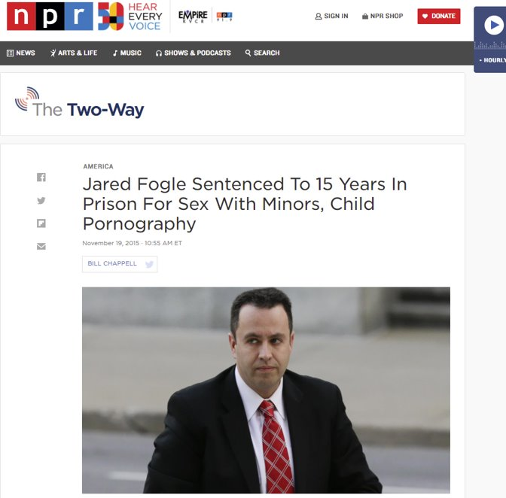
Consequences
Notes:
Another example: Jared Fogle was known for 15 years (2000-2015) as the Subway (sandwich shop) spokesperson. He was dropped when he was accused of possession of child pornography in 2015.​
The consequences of possessing child pornography reach beyond the law, though that’s bad enough: it ruins reputations for life.

Slide 13
Resources
National (Federal) Sex Offender Registry
https://www.nsopw.gov/
State Specific Sex Offender Registries:
California: https://www.meganslaw.ca.gov/mobile/Disclaimer.aspx
Texas: https://records.txdps.state.tx.us/SexOffenderRegistry
Pennsylvania: https://www.pameganslaw.state.pa.us/Home/TermsAndConditions
Louisiana: http://www.lsp.org/socpr/default.html
Kentucky: http://kspsor.state.ky.us/
Child Welfare Cases
Notes:
[Include laws and resources specific to your state. Provide these to students either as a separate handout or a print-out of the PowerPoint slides.]
For Child Welfare cases, depending on the state, if your child is removed from you due to abuse or neglect (even not involving sexual abuse), you could be denied the opportunity to get your child back due to your sex offender status.

Slide 14
Thank you
Questions?

