Slide 1
Criminal Law: ABCs
[Inn Name], [Presenters]
May 27, 2021
Notes:
[If this is your first presentation during the program, introduce yourselves and explain the American Inns of Court. Presenters are encouraged to speak from their experience as appropriate during the presentation. This helps students connect with you as the presenter and with the material.
Reminder: This presentation is a template. Feel free to adapt it as needed.]

Slide 2
The ABCs
Arrest
Bond
Court appearances
Notes:
In this presentation, we will cover three major aspects of a criminal law violation: the arrest, bond and bail, and appearing in court.

Slide 3
Arrest
Handcuffed
Miranda Rights
What to do:
Silence
Attorney
www.mirandawarning.org/whatareyourmirandarights
Notes:
When you are arrested, you will be handcuffed and placed into a police car. You will be transported to the local police station / jail, where you will be processed. This will include taking your picture and vital statistics (name, date of birth, height, weight, hair color, eye color, driver’s license number, etc.)
You may also be questioned about your role in a crime if the arrest involves anything other than a minor traffic violation. You will be given your Miranda rights and warnings. I’m sure you have heard these rights on various television shows, but we will go over them again. “You have the right to remain silent. Anything you say can and will be used against you in a court of law. You have the right to an attorney. If you cannot afford an attorney, one will be provided for you. Do you understand the rights I have just read to you? With these rights in mind, do you wish to speak to me?”
Why are these called Miranda rights? It was named so, due to a landmark U.S. Supreme Court Case, Miranda v. Arizona, where the Supreme Court held that the admission of an elicited incriminating statement by a suspect not informed of these rights violates the Fifth Amendment and the Sixth Amendment right to counsel, through the incorporation of these rights into state law. Before that case was decided in 1966, law enforcement was able to routinely get suspects to incriminate themselves.
What should you do? Exercise your right to remain silent AND your right to an attorney!
[Resource for arrest and police interactions: https://www.npr.org/local/309/2019/08/27/754459083/having-the-talk-expert-guidance-on-preparing-kids-for-police-interactions.]

Slide 4
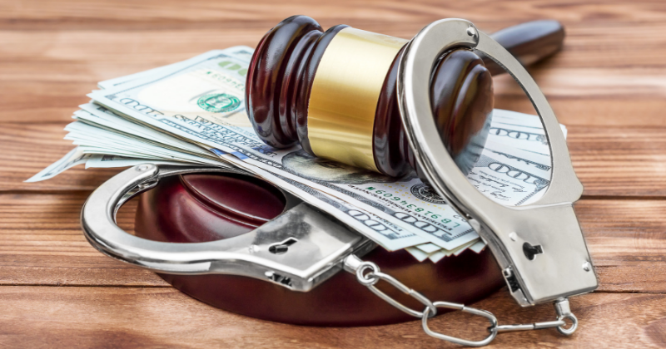
Bonds and Bail
This Photo by Unknown Author is licensed under CC BY-NC-ND
Notes:
After you have been arrested, you will be processed at the police station. Once you are processed in the law enforcement system, you may be able to get out of jail, pending a court appearance, depending on the jurisdiction and the severity of the crime. You, your family, and/or friends would either come up with the full amount of the bond (aka bail) or a minimum of 10% of that amount and an IOU, secured by various property, to a registered bail bonds company.

Slide 5
Court Appearances
Notes:
There are several types of court hearings/appearances in criminal court. We will cover a few briefly.

Slide 6
First Appearance
When
Attorney
Plea
This Photo by Unknown Author is licensed under CC BY-SA
Notes:
Your first court appearance would be the arraignment. At the arraignment, if you are not already released from custody, the amount of bail to secure your release will be determined by the judge. Again, the amount varies by jurisdiction and severity of the crime. In some instances, you might be released on your own recognizance, which means that you promise to appear every time in court and you do not need to pay any bail. At the arraignment, you would be appointed an attorney if you cannot pay for one. This attorney is typically called a public defender.
When you appear in court, you should wear business or business casual clothing (no jeans, T-shirts, sneakers, etc.). When you are asked to speak, speak respectfully, clearly, and concisely.
[Discuss what to bring and how to prepare—give an attorney's perspective on what the client should do and how their attorney should prepare them.]

Slide 7
Subsequent Appearances
Attorney
Plea
This Photo by Unknown Author is licensed under CC BY-NC-ND
Notes:
Subsequent appearances would be set, to determine whether this matter is ready to proceed to trial or whether you and your attorney are able to resolve (settle) the case with the prosecution. If you are able to settle the case, this would involve a “plea bargain.”
You, the defendant, would plead guilty to the crime with which you were charged, or a lesser crime. Your presence is mandatory at the subsequent appearances as you will be required to sign paperwork to agree to settle the case before trial.

Slide 8
Trial
Attorney
Plea
This Photo by Unknown Author is licensed under CC BY
Notes:
If you are not able to settle the case before trial, a trial date will be set. There is still the opportunity to plea while the trial is in progress, although the plea may be to the crime committed, rather than a lesser crime.
If you are found guilty of the crime, you would have subsequent hearings as well, to determine your punishment.
If you are found not guilty of the crime, you are done with your court appearances.

Slide 9
Thank you
Questions?

