Slide 1
Constitutional Rights
[Inn Name], [Presenters]
May 27, 2021
Notes:
[If this is your first presentation during the program, introduce yourselves and explain the American Inns of Court. Presenters are encouraged to speak from their experience as appropriate during the presentation. This helps students connect with you as the presenter and with the material.
Reminder: This presentation is a template. Feel free to adapt it as needed.]

Slide 2
What protects the rights of U.S. citizens?
Why do we need it?
Notes:
What is it? The Bill of Rights is the first 10 Amendments to the Constitution. It spells out Americans’ rights in relation to their government.
How did it happen? These amendments were proposed by James Madison to help win support for the formation of the new federal government. To get Congress and the States to ratify—or approve—the Constitution, Madison knew the founders would need to provide some protection for people’s individual rights. There were initially 17 amendments. A joint House and Senate Conference Committee settled on 12. On October 2, 1789, President Washington sent copies of the 12 amendments adopted by Congress to the states. By December 15, 1791, three-fourths of the states had ratified 10 of these, now known as the “Bill of Rights.”
Why do we need it? It guarantees civil rights and liberties to the individual—like freedom of speech, press, and religion. It sets rules for due process of law and reserves all powers not delegated to the Federal Government to the people or the States. Basically, the Bill of Rights ensures people’s individual rights are protected.

Slide 3
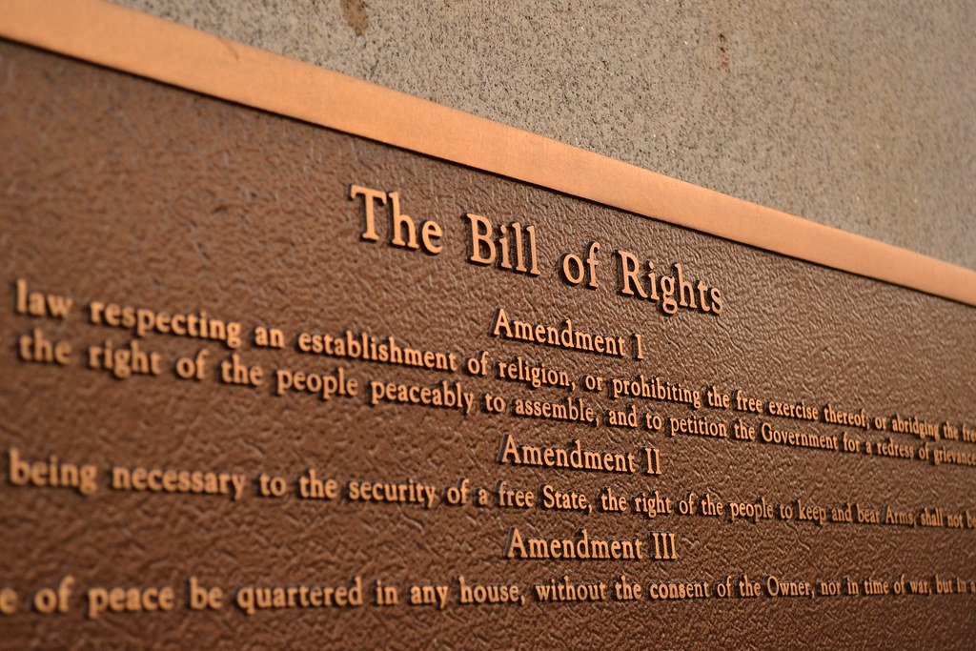
The Bill of Rights
This Photo by Unknown Author is licensed under CC BY
Notes:
[Go through these very briefly.]
First: provides several rights protections: to express ideas through speech and the press, to assemble or gather with a group to protest or for other reasons, and to ask the government to fix problems. It also protects the right to religious beliefs and practices. It prevents the government from creating or favoring a religion.
Second: protects the right to keep and bear arms.
Third: prevents government from forcing homeowners to allow soldiers to use their homes. Before the Revolutionary War, laws gave British soldiers the right to take over private homes.
Fourth: bars the government from unreasonable search and seizure of an individual or their private property.
Fifth: provides several protections for people accused of crimes. It states that serious criminal charges must be started by a grand jury. A person cannot be tried twice for the same offense (double jeopardy) or have property taken away without just compensation. People have the right against self-incrimination and cannot be imprisoned without due process of law (fair procedures and trials.)
Sixth: provides additional protections to people accused of crimes, such as the right to a speedy and public trial, trial by an impartial jury in criminal cases, and to be informed of criminal charges. Witnesses must face the accused, and the accused is allowed his or her own witnesses and to be represented by a lawyer.
Seventh: extends the right to a jury trial in Federal civil cases.
Eighth: bars excessive bail and fines and cruel and unusual punishment.
Ninth: states that listing specific rights in the Constitution does not mean that people do not have other rights that have not been spelled out.
Tenth: says that the Federal Government only has those powers delegated in the Constitution. If it isn’t listed, it belongs to the states or to the people.

Slide 4
Name That Amendment!
[Insert poll short URL/text-in number here]
Notes:
[This is a suggested activity to help students connect with what they are learning. If students have their phones with them, create a text-in poll so they can see the results on screen in real time. Some online polling platforms include:
* www.directpoll.com
* www.polleverywhere.com
* www.sli.do
Once you create your poll, you should receive a text-in number or link. Insert the link or number on this slide so that students can participate in the poll.
If there is time, encourage discussion around each of the quiz answers.]

Slide 5
Which Amendment?
Notes:
Scenario: A woman is picked up by [state] police under suspicion of having robbed a convenience store three days ago. She is taken to two different police stations and interrogated for three hours. Eventually, she admits to the crime. At trial, the oral confession and the transcript are presented to the jury. The woman is found guilty of first degree robbery and sentenced to 30-60 years in prison.
Case cited: Vignera v. New York

Slide 6
Which Amendment?
A: Sixth Amendment (rights to a speedy and public trial, right to an attorney, witnesses, etc.)
B: Eighth Amendment (no cruel and unusual punishment)
C: Fifth Amendment (fair procedures and trials)
Notes:
[Show poll results before showing answers.]

Slide 7
Which Amendment?
A: Sixth Amendment (rights to a speedy and public trial, right to an attorney, witnesses, etc.)
B: Eighth Amendment (no cruel and unusual punishment)
C: Fifth Amendment (fair procedures and trials)

Slide 8
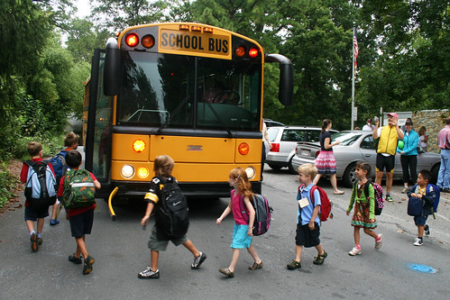
Which Amendment?
This Photo by Unknown Author is licensed under CC BY-NC
Notes:
Scenario: [State] said it was legal for the school board to reimburse parents for busing children to private schools, including Catholic schools. A taxpayer living in the state sued the school board claiming it was unlawful for the state to require him to pay taxes for kids attending religious academies. However, the Supreme Court upheld the state’s law.
Case cited: Everson v. Board of Education

Slide 9
Which Amendment?
A: First Amendment (freedom of speech, religion, assembly, press, and petition)
B: Ninth Amendment (rights reserved to the people)
C: Tenth Amendment (Federal government only has powers listed in the Constitution)
Notes:
[Show poll results before showing answers.]

Slide 10
Which Amendment?
A: First Amendment (freedom of speech, religion, assembly, press, and petition)
B: Ninth Amendment (rights reserved to the people)
C: Tenth Amendment (Federal government only has powers listed in the Constitution)

Slide 11
Which Amendment?
This Photo by Unknown Author is licensed under CC BY-SA
Notes:
Scenario: A policeman tries to register a legally-purchased handgun with the state of [state], which he intends to keep at home for personal use. However, he is told that no citizen of the state is authorized to own a handgun—even if it is for self-defense.
Case cited: District of Columbia et al. v. Heller

Slide 12
Which Amendment?
A: Second Amendment (right to bear arms)
B: First Amendment (freedom of speech, religion, assembly, press, and petition)
C: Ninth Amendment (rights reserved to the people)
Notes:
[Show poll results before showing answers.]

Slide 13
Which Amendment?
A: Second Amendment (right to bear arms)
B: First Amendment (freedom of speech, religion, assembly, press, and petition)
C: Ninth Amendment (rights reserved to the people)

Slide 14
Thank you
Questions?

