Slide 1
Civic Responsibility
[INN NAME], [PRESENTERS]
May 27, 2021
Notes:
[If this is your first presentation during the program, introduce yourselves and explain the American Inns of Court. Presenters are encouraged to speak from their experience as appropriate during the presentation. This helps students connect with you as the presenter and with the material.
Reminder: This presentation is a template. Feel free to adapt it as needed.]

Slide 2

Overview
Jury duty
Voting
Taxes
Military service
This Photo by Unknown author is licensed under CC BY-SA.

Slide 3
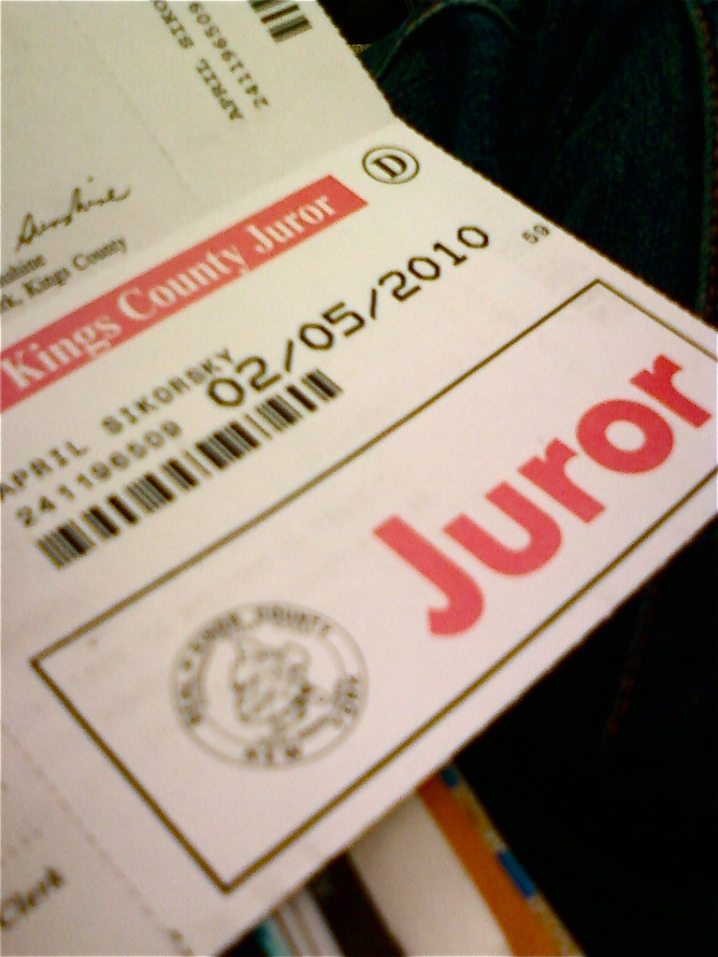

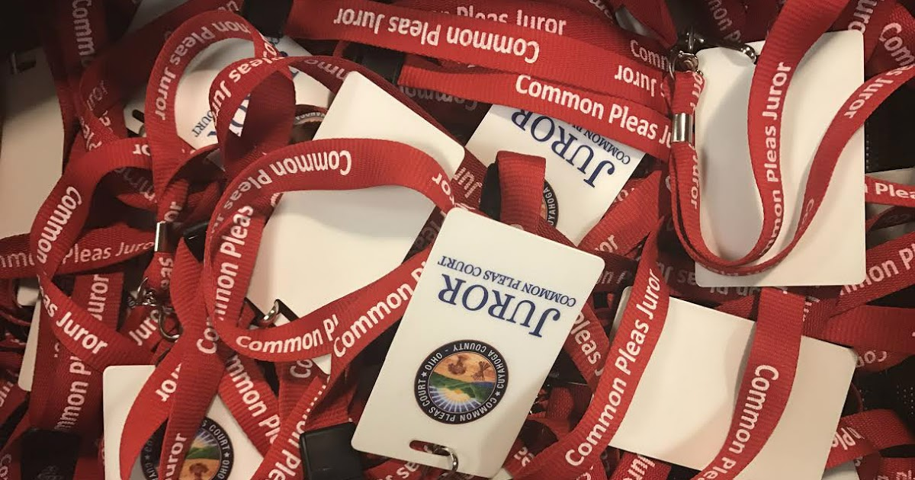
Jury Duty
This Photo by Unknown author is licensed under CC BY-SA-NC.
This Photo by Unknown author is licensed under CC BY-ND.
This Photo by Unknown author is licensed under CC BY-SA.
Notes:
[Explain the purpose of a jury. Explain the selection process (summons, questions, selection). Explain there are different kinds of cases that have juries. Explain what the duties of a jurist include and what to expect.]

Slide 4
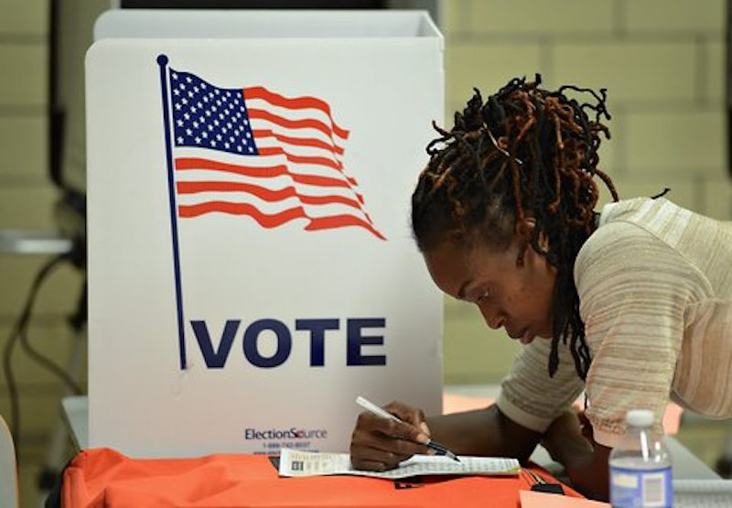
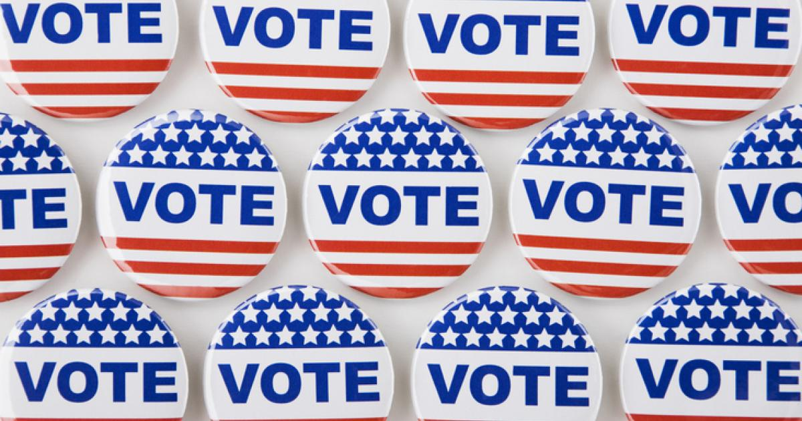
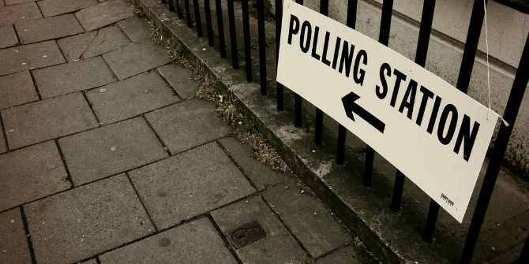
Voting
This Photo by Unknown author is licensed under CC BY-ND.
This Photo by Unknown author is licensed under CC BY.
This Photo by Unknown author is licensed under CC BY-NC-ND.
Notes:
Voting is not required, but is a citizen's right. A citizen's vote is confidential. There are local, state, and federal elections—each with their own timing based upon the office. You have to register to vote and keep registration current. There are different ways to vote—by mail and in person and, where in person, by different machines/methods. [Explore these points in more detail as time permits.]

Slide 5
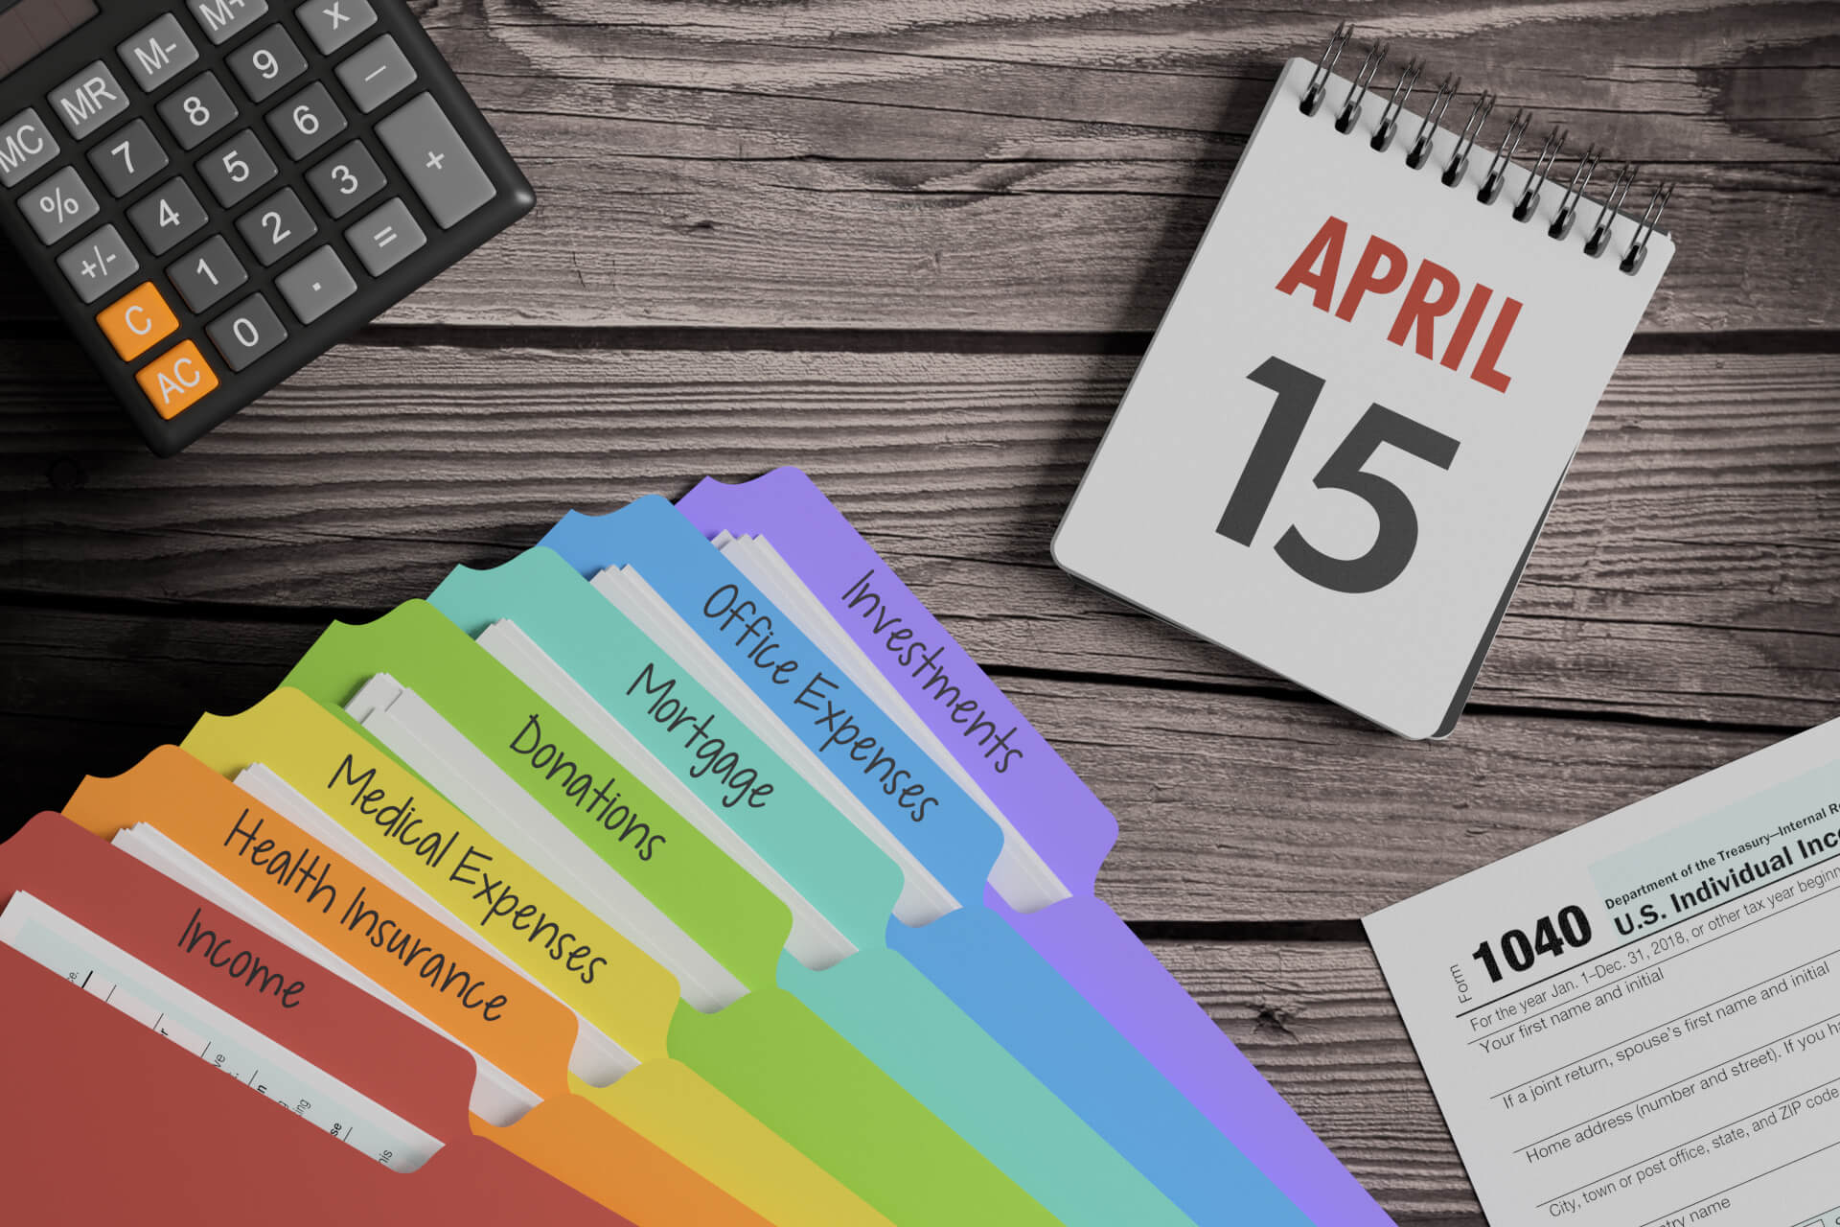
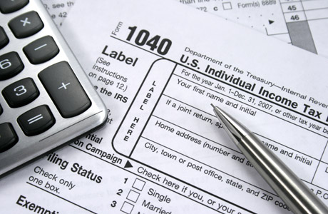
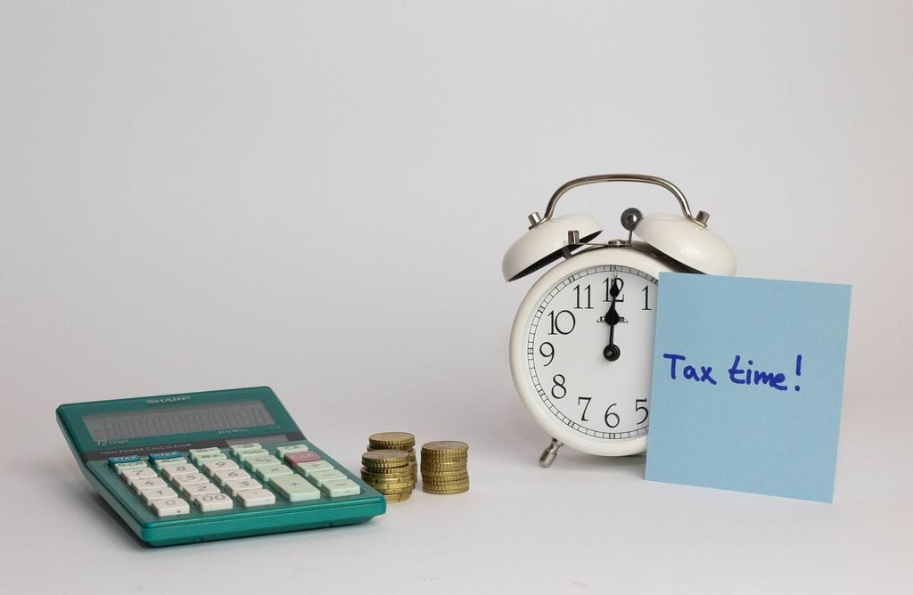
Taxes
This Photo by Unknown author is licensed under CC BY-ND.
This Photo by Unknown author is licensed under CC BY-NC-ND.
This Photo by Unknown author is licensed under CC BY.
Notes:
There are local, state, and federal taxes. Taxes fund government operations and public services (e.g., education, roads, libraries, etc.). Taxes are automatically deducted from your paycheck but must be filed annually (usually by April 15 for the previous year) to determine if you've paid enough over the course of the year or owed a refund for overpaying.

Slide 6

Military Service
www.sss.gov
This Photo by Unknown author is licensed under CC BY-SA.
Notes:
18-year old men must register for the selective service system also known as the draft.
"Selective Service registration is required by law as the first part of a fair and equitable system that, if authorized by the President and Congress, would rapidly provide personnel to the Department of Defense while at the same time providing for an Alternative Service Program for conscientious objectors. By registering, a young man remains eligible for jobs, Federal student aid, State-based student aid in 31 states, Federally-funded job training, and U.S. citizenship for immigrant men." [Source: www.sss.gov]
You can also voluntarily enter the military, or apply to attend military academies such as the Naval Academy in Maryland or West Point in New York.

Slide 7
Discussion Questions
If you had the authority to decide where to spend state taxes, what public services would you spend money on?
What are the benefits of having a jury decide your case? What could be some disadvantages?
Notes:
[Have students discuss questions in small groups, or answer in a large group as time permits.]

Slide 8
Thank you
Questions?

