Slide 5
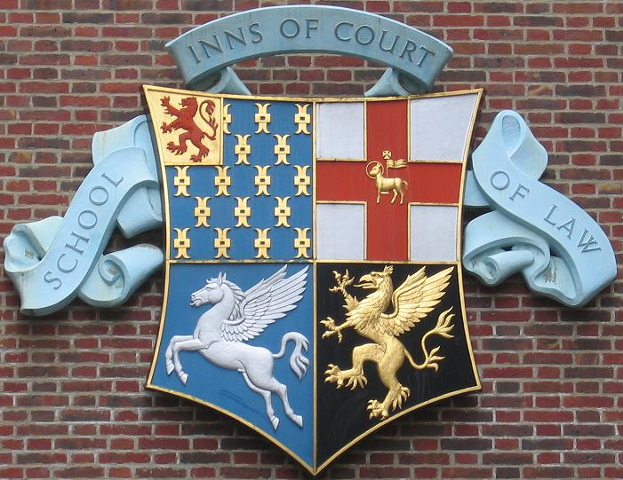
Combined arms of the four Inns of Court. Clockwise from top left: Lincoln's Inn, Middle Temple, Gray's Inn, Inner Temple.

Slide 6
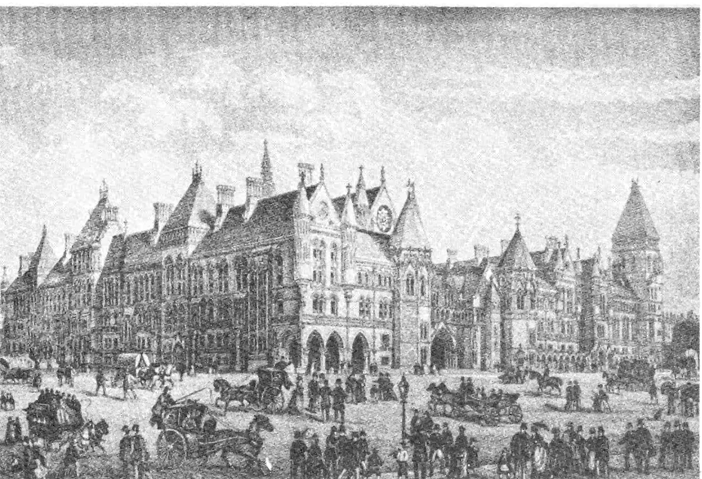
The Royal Courts of Law & Temple Bar

Slide 7
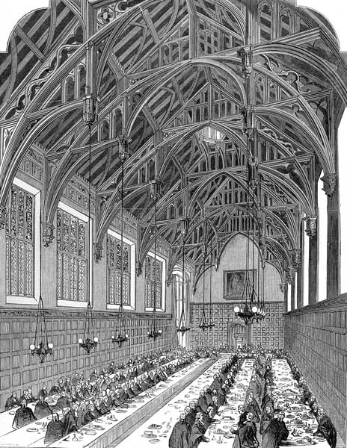
Lincoln’s Inn Great Hall 1845

Slide 8
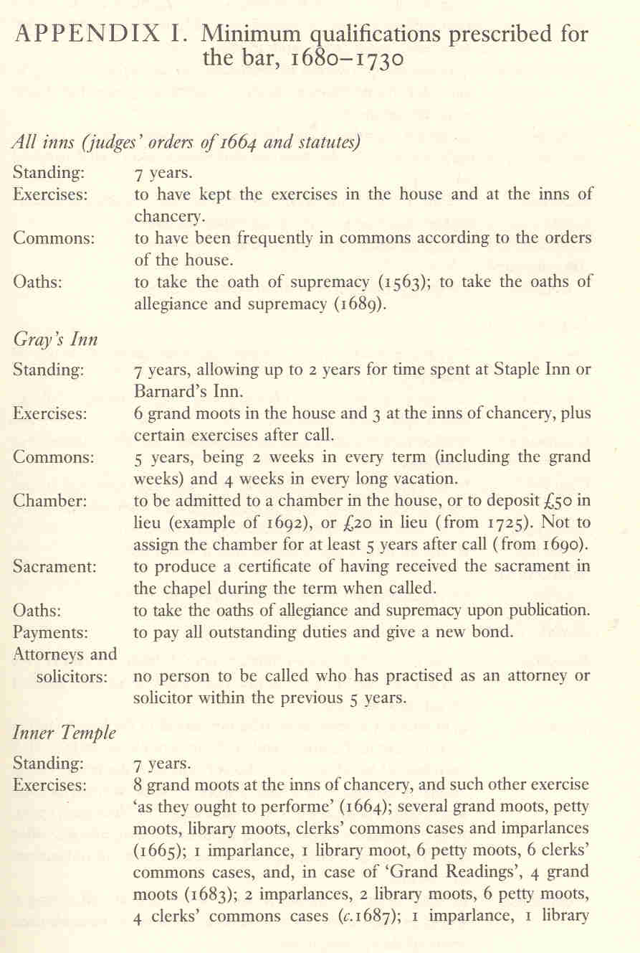
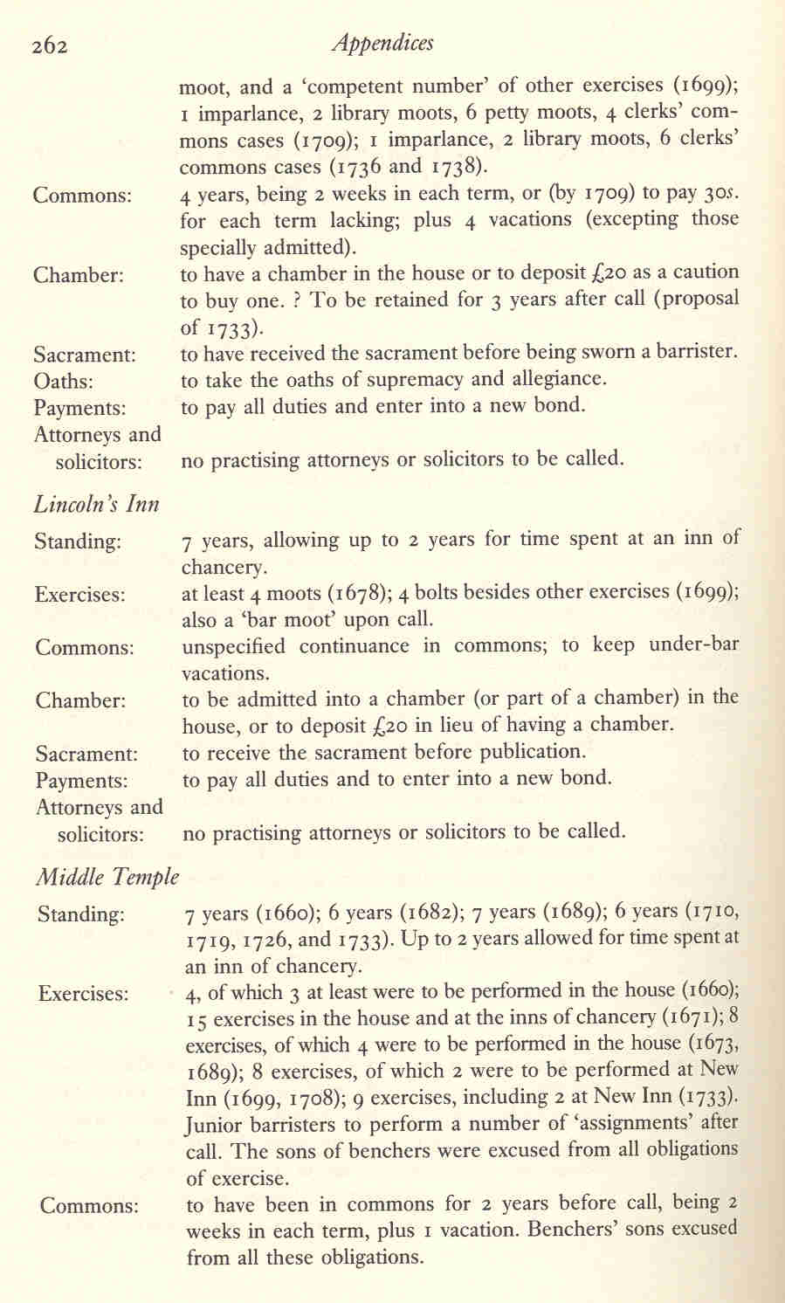
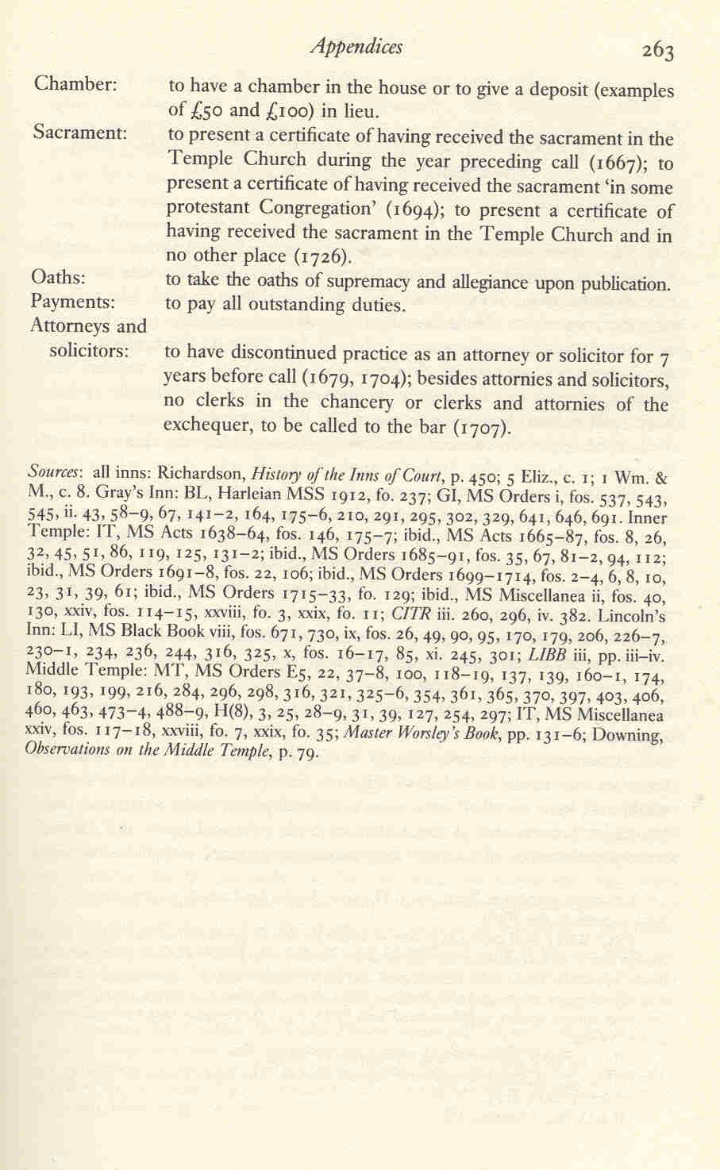
Minimum qualifications prescribed for the bar, 1680-1730

Slide 9
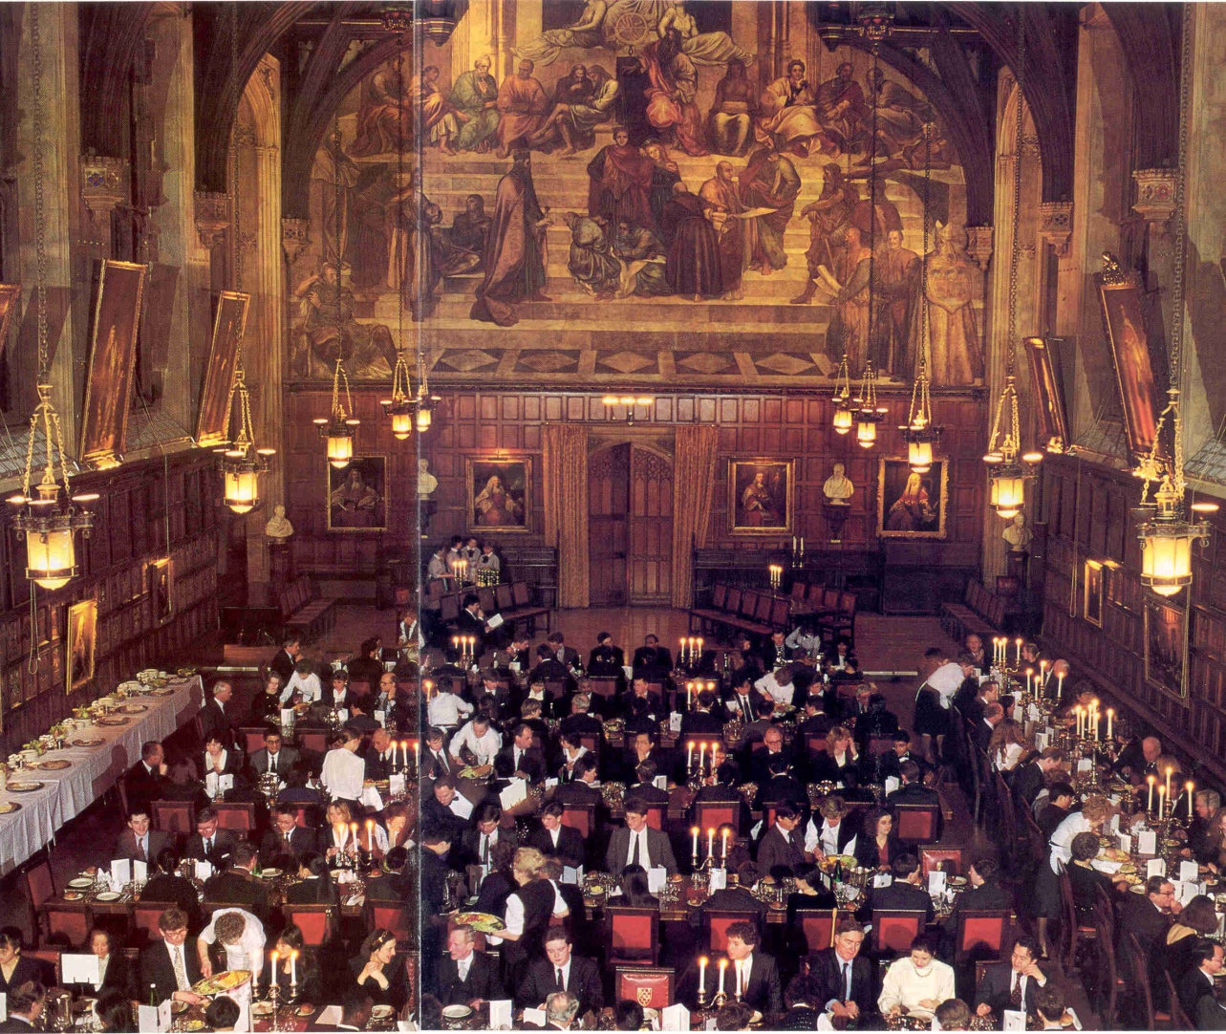
Lincoln’s Inn Great Hall
Before they can become barristers, students must eat 24 dinners, like this, in the Great Hall. The Great Hall was opened by Queen Victoria in 1845.

Slide 10
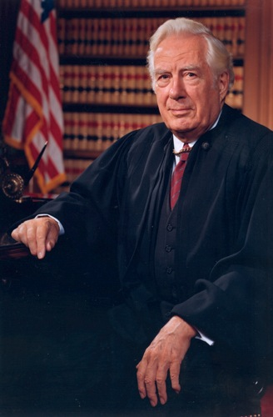
Chief Justice Warren E. Burger

Slide 21
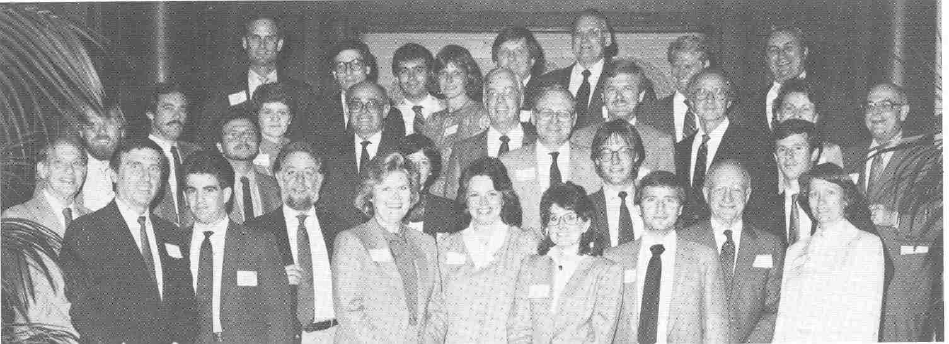
First Chester Bedell Inn of Court Banquet – Spring 1986

